Slide 1
统计学院
SCHOOL OF STATISTICS
Integrate Statistical System to
Deepen Trade Analysis
Jingping Li
Center for Applied Statistics, School of Statistics, RUC
jpli33@ruc.edu.cn
Nov. 25, 2021
Notes:
作者简介：Kurt Weyland

Slide 2
统计学院
SCHOOL OF STATISTICS
01
Backgrounds
02
Integration Analysis
03
Further Work
Notes:
作者简介：Kurt Weyland

Slide 3
统计学院
SCHOOL OF STATISTICS
Background
Part 1
What do we need for trade statistics
Status quo of trade statistics and enterprise statistics in China
How to integrate the two systems
Notes:
作者简介：Kurt Weyland

Slide 4
统计学院
SCHOOL OF STATISTICS
Requirements for Trade Statistics in the New Era
Guidelines on Promoting the Innovative Development of Foreign Trade
GBF [2020] No.40
Focusing on the construction of a new development pattern that domestic circulation is the main body and domestic and international double circulation promote mutually, we should accelerate the “five optimizations" of international market layout, domestic regional layout, business entities, commodity structure and trade mode, and the "three constructions“, i.e., foreign trade transformation and upgrading base, trade promotion platform, and international marketing system. Cultivate new advantages in participating in international cooperation and competition under the new situation, and achieve innovative development of foreign trade.
  Cultivate leading enterprises with global competitiveness
  Enhance the trade competitiveness of SMEs
Notes:
各种布局如何度量？不同视角的布局如何联系起来观察？贸易行为主体是企业，任何一方面的优化都需要企业来具体实现。
龙头企业如何识别？中小企业如何识别？是根据贸易量还是企业总体规模？
贸易竞争力如何度量？仅仅观察贸易额可以吗？贸易竞争力最终体现为企业的创新能力和生产效率。

Slide 5
统计学院
SCHOOL OF STATISTICS
Requirements for Trade Statistics in the New Era
Guidelines on Accelerating the Development of New Forms and Models of Foreign Trade
GBF [2021] No.24
By 2025, the institutional mechanisms and policy systems for the development of new formats and new models of foreign trade will be improved, the business environment will be optimized, a number of leading enterprises and industrial clusters with international competitiveness will be strengthened, the level of the industrial value chain will be upgraded, and the leading role of foreign trade and the national economy is further enhanced.
Promote the data docking among commerce, customs, taxation, market supervision, postal and other departments to strengthen the supervision of tax evasion, counterfeit and inferior transactions, and false transactions besides streamlining services. Improve the foreign trade statistical system of new business formats and new models.（MOFCOM takes the lead，GACC, SATC, SAMR, NBS, CSPB cooperate according to their own responsibilities）
Notes:
产业集群是否形成？如何发展变化？产业价值链如何度量？
哪些是外贸新业态新模式？
国家统计局在贸易创新发展过程中如何发挥作用？仅仅事后提供数据，还是利用企业统计数据资源，深入分析贸易现状、趋势和问题，为贸易发展提供引领性建议。

Slide 6
统计学院
SCHOOL OF STATISTICS
Customs Statistics
Customs Declaration
domestic consignee/consignor, entry/exit customs, import/export date, overseas consignee/consignor, mode of transport, name od means of transportations, consuming and using unit/producing and sale unit, mode of supervision, trading country(region), country(region) of departure/arrival, port of entry/departure, transaction method, freight, premium, miscellaneous charges, commodity name, specification and model, quantity and unit, unit price, total price, currency system, country(region) of origin, final destination country(region), domestic destination/domestic source of goods, etc.
Notes:
根据海关总署公告2016年第20号（关于修订《中华人民共和国海关进出口货物报关单填制规范》的公告），新版报关单已将原“经营单位”改为“收发货人”，将原“收货单位”改为“消费使用单位”（进口时），将原“发货单位”修改为“生产销售单位”（出口时）。
在实际报关业务中，进口货物报关单上的“境内收货人（报关公司）”和“消费使用单位”这两栏所填报的名称和十位号通常是一样的。当境内收货人和消费使用单位不一致时，就要境内收货人（报关公司）和消费使用单位的《委托代理协议》，即消费使用单位委托境内收货人（报关公司）对外签订外贸合同并以经营单位的名义进行报关，此种情况通常称为“双抬头”。
对于出口，”发货人”填报在海关注册的对外签订并执行出口贸易合同的中国境内法人、其他组织或个人的名称及编码；“生产销售单位”填报出口货物在境内的生产或销售单位的名称，包括自行出口货物的单位或委托出口企业出口货物的单位。注意，生产销售单位分为生产单位和销售单位，生产单位通常指工厂，销售单位通常指外贸公司或进出口公司。对于代理出口的业务，若A公司出口且是自营出口，则收发货人和生产销售单位都为A公司；若A公司委托代理企业B代理出口，则收发货人为B公司，生产销售单位为A公司。

Slide 7
统计学院
SCHOOL OF STATISTICS
Enterprise Statistics
Industrial Enterprises Statistics
Wholesale and Retail Enterprises Statistics
Scope
industrial legal entities above designated scale (annual revenue of 20 million RMB and above)
Indicators
basic information, employees, financial status, production and operation, research and development activities and innovation, informatization and e-commerce, etc.
  export delivery value
Scope
wholesale and retail legal entities above designated scale (wholesale enterprises: annual revenue of 20 million RMB and above; retail enterprises: annual revenue of 5 million RMB and above)
Indicators
basic information, financial status, and operating conditions
  commodity purchase value - imports
  commodity sales value - exports
Notes:
出口交货值、商品进口和出口只统计汇总数据，没有细分商品数据

Slide 8
统计学院
SCHOOL OF STATISTICS
The Two Statistical Systems are Independent of Each Other
Industrial Statistics
Wholesale and Retail Trade Statistics
export only, no import information
export information includes commodity information only, nothing about trading counterparties
total imports or exports only, no product classification information
no information about consume and use unit/produce and sale unit of the goods
no information on trading counterparties
Customs Statistics
only the name of the enterprise, no further information such as type, production and financial statistics, etc.
Notes:
2015年9月18日工商总局印发文件《工商总局关于调整新版营业执照打印技术标准及有关事项的通知》，对营业执照进行调整，将营业执照正副本照面加载的15位注册号调整为18位的法人和其他组织统一社会信用代码（个体工商户营业执照除外），其标识方法由“注册号”字样，调整为“统一社会信用代码”。

Slide 9
统计学院
SCHOOL OF STATISTICS
Disadvantages of the Independence
Information of traders and corresponding transactions are separated.
The analysis is restricted. It is difficult to connect foreign trade analysis with enterprise development analysis. It is not conductive to analyze the structural characteristics of foreign trade and it is also not conductive to formulate and implement precise foreign trade policies.
  Are the leading foreign trade enterprises sustainable ?
  Which enterprises highly depend on foreign trade?
  Which enterprises' foreign trade is greatly affected by emergencies?
  Has the foreign trade policy achieved the expected effect?
Notes:
https://new.qq.com/omn/20210204/20210204A03UO600.html
正略咨询：经济新常态下的国际贸易行业发展趋势
贸易由传统中介向供应链服务及供应链金融拓展。
一是拓展供应链服务。目前我国市场中的贸易商以“采购执行（专业买手）+销售执行（专业卖手）+供应链服务模式”为主，包括进出口通关、物流配送、仓储及库存管理、信息以及结算配套等环节，贸易企业在提供前端专业采购、后端专业销售的传统纯买卖服务上，提供配套的一揽子供应链服务。
二是配套供应链金融。通过为贸易链条上中小企业提供物权或债权融资服务，管理中小企业资金流，盘活资金同时加强客户黏性。一达通为代表的一系列外贸综合服务平台，掌握了完整的贸易交易流程和应收账款，能够最大程度地减低中小型企业的融资风险，并通过规模化运作的方式提高效率，为银行和需要贷款的企业承载其融资责任，为其提供直接的贸易融资。
外贸企业通过外贸综合服务平台进出口之后，其在海关、保险、物流等环节的相关业务数据就会在平台中沉淀下来。运用互联网大数据技术，将企业在平台产生的贸易数据转化为企业信用，提供各种供应链金融产品，大幅度降低企业各项交易成本。中小企业凭借其信用在较短时间内获取较低成本的融资，解决融资难题。

Slide 10



统计学院
SCHOOL OF STATISTICS
The Necessity of Integration of the Two Systems
Meet the new trends in world trade development
Meet and lead the requirements of the innovative development of new foreign trade
Meet the need to improve the current statistical work
Notes:
2019年4月27日，由孙冶方经济科学基金会、浙江省社会科学界联合会、浙江财经大学联合主办的第三届中国经济学家高端论坛在杭州隆重举行，黄奇帆出席并演讲。他指出，近40年以来世界贸易的格局、企业组织和管理的方式、国家和国家之间贸易有关的政策均发生了重要的变化。这三个变化分别表现为服务贸易的比重大大提高，产业链、供应链和价值链的管控越来越重要，以及零关税、零壁垒和零补助是大势所趋。

Slide 11
统计学院
SCHOOL OF STATISTICS
International Experience Based on Corporate Foreign Trade Statistics: OECD and EU
International trade in goods - trade by enterprise characteristics (TEC)
The main objective of the (TEC) is to bridge two major statistical domains which have traditionally been compiled and used separately, business statistics and international trade in goods statistics (ITGS). Specifically, this new domain was created to answer questions such as:
  What kind of businesses are behind the trade flows of goods?
  What is the contribution of a particular activity sector to trade?
  What is the share of small and medium-sized enterprises to total trade?
  What is the share of enterprises that trade with a certain partner country and the amount of trade value they account for?
The trade in goods between countries is broken down by economic activity, size-class of enterprises, trade concentration, geographical diversification and products traded.
Both the export and import values and the number of exporting and importing enterprises are available for 26 OECD and 6 non-OECD countries: including 28 EU member states plus Canada, Norway, Israel, Turkey and the United States.
https://www.oecd.org/sdd/its/trade-by-enterprise-characteristics.htm
https://ec.europa.eu/eurostat/cache/metadata/en/ext_tec_sims.htm#stat_pres1628781796279
Notes:
Business registers for statistical purposes, or statistical business registers (SBR), are the main sources for business demography, as they keep track of business creations and closures as well as the structural changes in the economy by concentration or deconcentration, brought about by operations such as mergers, takeovers, break-ups, split-offs and restructuring.

Slide 12
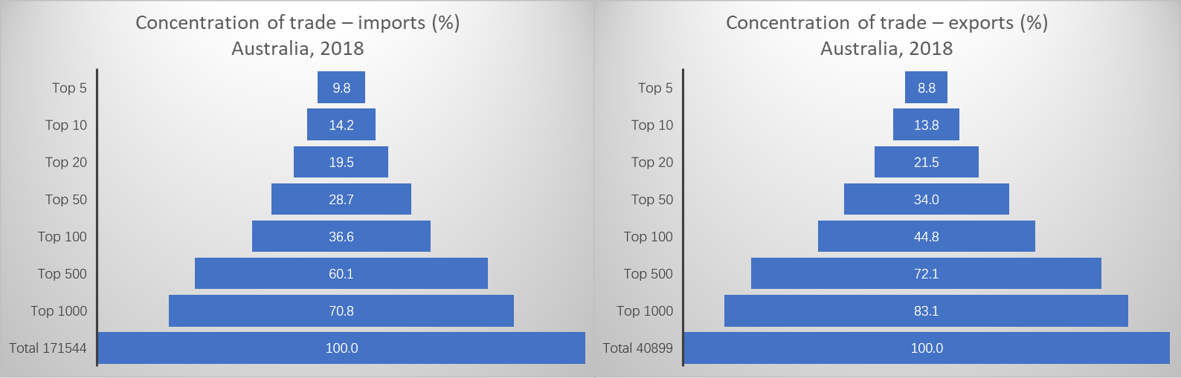
统计学院
SCHOOL OF STATISTICS
Example: TEC Application in Australia
Data Source：http://www.statistik.at/web_en/statistics/Economy/foreign_trade/tec_trade_by_enterprise_characteristics/index.html
Notes:
进口 出口
企业数 金额 企业数 金额
0.003 9.8 0.012 8.8
0.006 14.2 0.024 13.8
0.012 19.5 0.049 21.5
0.029 28.7 0.122 34.0
0.058 36.6 0.245 44.8
0.291 60.1 1.223 72.1
0.583 70.8 2.445 83.1
100.0 100.0 100 100.0

Slide 13
统计学院
SCHOOL OF STATISTICS
International Experience Based on Corporate Foreign Trade Statistics: USA
Longitudinal Firm Trade Transactions Database (LFTTD) 1992–2018
The Longitudinal Firm Trade Transactions Database (LFTTD) links individual trade transactions to the U.S. firms that make them. That is, it links export transactions to the U.S. exporter and import transactions to the U.S. importer. The LFTTD contains the same firm identifier found in many other Census data products.
This dataset has two components. Matching the two components yields the LFTTD.
  Foreign trade data assembled by the U.S. Census Bureau and U.S. Customs captures all U.S. international trade.
  Longitudinal Business Database (LBD) of the U.S. Census Bureau, which records annual employment, industry (4-digit 1987 Standard Industrial Classification SIC4), and survival information for most U.S. establishments.
https://ec.europa.eu/eurostat/cache/metadata/en/ext_tec_sims.htm#stat_pres1628781796279
Notes:
Business registers for statistical purposes, or statistical business registers (SBR), are the main sources for business demography, as they keep track of business creations and closures as well as the structural changes in the economy by concentration or deconcentration, brought about by operations such as mergers, takeovers, break-ups, split-offs and restructuring.

Slide 14
统计学院
SCHOOL OF STATISTICS
Basic Ideas of Integrating the Two Statistical Systems
Take enterprise as the join field and link the bottom data of two statistical systems
Observe comprehensively and deeply through multi-dimensional classification
Use big data analysis methods to develop new data products
Dimension
Analysis
By the industry of the enterprise
By the ownership of the enterprise
By the scale of the enterprise
By the region of the enterprise
By the partner country
……
Cross classification
Formulate new indicator
Explore social network
Recommendation system
Forecast
……

Slide 15
统计学院
SCHOOL OF STATISTICS
Basic Steps to Integrate the Two Statistical Systems
Link source data
Multi-dimensional classification
data analysis
data release

Slide 16
统计学院
SCHOOL OF STATISTICS
Questions that can be Answered by Integrating the Two Statistical Systems
Connect trade statistics with enterprise statistics to reflect foreign trade activities and the contribution of trade to the economy from the perspective of the traders.
  the structure of traders in foreign trade
  contributions of different traders in foreign trade
  characteristics of different traders in foreign trade activities
  contribution of foreign trade to the development of different traders

Slide 17
统计学院
SCHOOL OF STATISTICS
Integration Analysis
Part 2
General Idea
Indicator Establishment
Big Data Statistical Analysis
Notes:
作者简介：Kurt Weyland

Slide 18
统计学院
SCHOOL OF STATISTICS
Basic Idea of ​​Integration Analysis
Basic Analysis
Further Analysis
Static Analysis
Dynamic Analysis
key indicator
dashboard indicator system
multi-dimensional classification
dill-down analysis
distribution
core enterprise
core commodities
retention analysis
transfer analysis
trend forecast
Notes:
“Indicators are a way of seeing the big picture by looking at a small piece of it” （Plan Canada ）
Indicators have become widely used in many different fields and play a useful role in highlighting problems, identifying trends, and contributing to the process of priority setting, policy formulation and evaluation and monitoring of progress.

Slide 19
统计学院
SCHOOL OF STATISTICS
Formulation and Selection of Economic Indicators
  “Indicators are a way of seeing the big picture by looking at a small piece of it.”（Plan Canada）
    The origin of indicator is the raw data. The purpose is to create new features with obvious economic or statistical significance and convert the original features into new ones.
  pinpointing problems; identifying trends; setting priority; monitoring progress; forecasting.
  Formulation methods: combining or decomposing
  Selection principles: economic implications; statistical relevance; management feasibility
Data and features determine the upper limit of machine learning, while models and algorithms only approach this upper limit.
Notes:
“Indicators are a way of seeing the big picture by looking at a small piece of it” （Plan Canada ）
Indicators have become widely used in many different fields and play a useful role in highlighting problems, identifying trends, and contributing to the process of priority setting, policy formulation and evaluation and monitoring of progress.

Slide 20
统计学院
SCHOOL OF STATISTICS
Examples of Indicators
  The structure of traders in foreign trade. For specific commodity, calculate the foreign trade share of
    above(below)-scale enterprises / enterprises of strategic importance / state-owned (private, foreign-funded) enterprises
  Concentration of trading enterprises. For specific commodities, calculate
    market share of top k import and export enterprises; Gini coefficient; Theil index
  Concentration of trading partners. For specific commodities, calculate
    market share of top k trading partner countries; Gini coefficient; Theil index
  The trade dependence of the enterprises. For specific enterprises, calculate
    imports/total output (value added; operating income; fixed assets; current assets); export/total output (value added; operating income)

Slide 21


统计学院
SCHOOL OF STATISTICS
Combine Static and Dynamic Analysis
Static Analysis
Dynamic Analysis
Distribution on certain time point or period.
  concentration of trade value in a certain dimension.
$$H_{k}=\sum_{i=1}^{k}{w_{i}}$$
Explore trade structure based on cross-tabulation.
  commodity category × ownership of enterprise
  trade country × enterprise size
Comparison between different time.
  compare the changes of concentration in different periods
Establish indicators to reflect changes in trade structure
  Lawrence index: reflect the changes of a certain enterprise’s source countries of import and export
$$L=\frac{1}{2}\sum_{i=1}^{k}{\left|w_{it}−w_{i,t−1}\right|}$$
Notes:
作者简介：Kurt Weyland

Slide 22
统计学院
SCHOOL OF STATISTICS
Big Data Analysis Framework for integrated Trade-Enterprise
Descriptive Statistics
visualization
Network Analysis
enterprise network
Trend Prediction
ARIMA
commodity network
country network
machine learning
Notes:
作者简介：Kurt Weyland

Slide 23
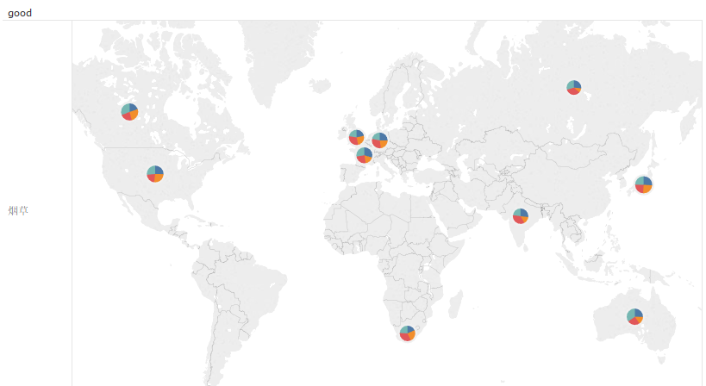
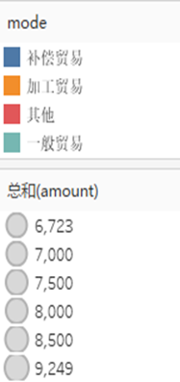
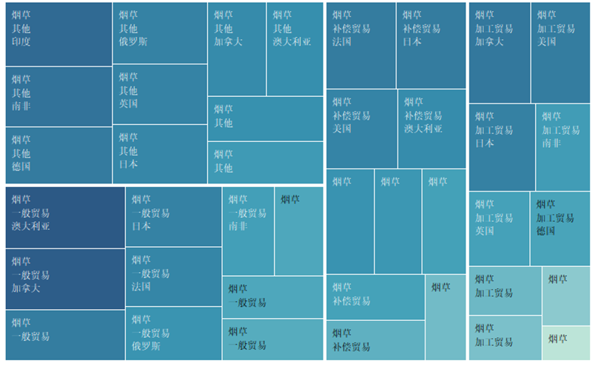
统计学院
SCHOOL OF STATISTICS
Visualization - Structure Trend Chart
A commodity of an enterprise above scale: trade country × trade mode
trade map
brick map
Notes:
作者简介：Kurt Weyland

Slide 24
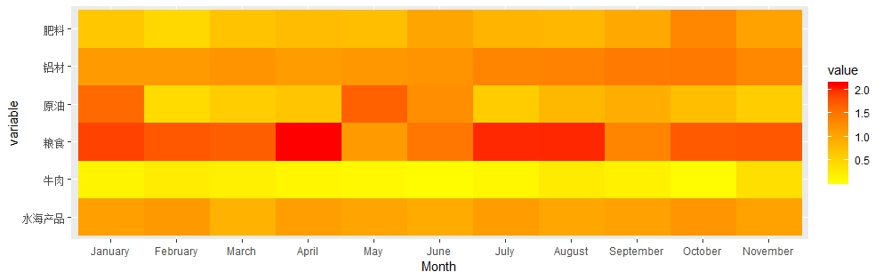
统计学院
SCHOOL OF STATISTICS
Visualization - Commodity Monitory Chart
thermal diagram of imported commodity
Notes:
作者简介：Kurt Weyland

Slide 25
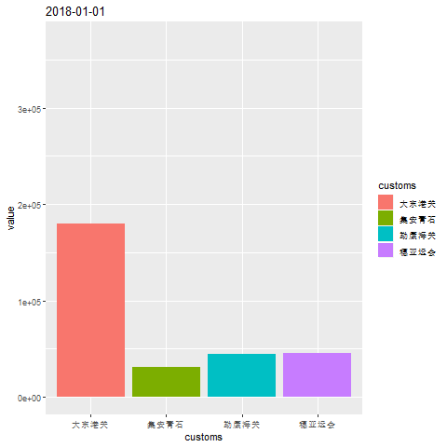
统计学院
SCHOOL OF STATISTICS
Visualization - Dynamic Graph
dynamic chart of trade value
Notes:
作者简介：Kurt Weyland

Slide 26
统计学院
SCHOOL OF STATISTICS
Network Analysis
Network construction
enterprise network; commodity network; country network
Network analysis
  General analysis: network diameter, connected components, path length, degree distribution, clustering coefficient, network density
  Node centrality: degree centrality, closeness centrality, intermediation
  Community discovery: FN algorithm, spectral clustering algorithm
Notes:
作者简介：Kurt Weyland

Slide 27
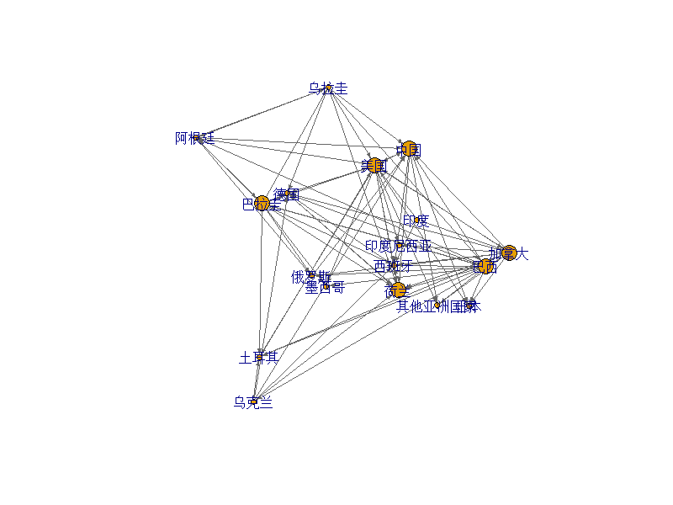
统计学院
SCHOOL OF STATISTICS
Network of Commodity Trading Countries
Reflecting the trade situation, trade relations and strategic position
Directed weighted graph
Node: (main) country
Edge weight: import/export volume
Network density：0.235
Clustering coefficient：0.485
Network diameter：3
soybean（HS1201）trade network，2017
Notes:
作者简介：Kurt Weyland

Slide 28
统计学院
SCHOOL OF STATISTICS
Network Centrality of Soybean
Country/Region | Out-Degree | In-Degree | Closeness Centrality | Intermediary
Brazil | 0.647 | 0.118 | 5.15E-08 | 0
Canada | 0.647 | 0.118 | 5.82E-08 | 0.287
China | 0.294 | 0.412 | 7.45E-08 | 0.728
Germany | 0.118 | 0.412 | 6.69E-08 | 0
Netherlands | 0.118 | 0.471 | 6.16E-08 | 0
Paraguay | 0.588 | 0.118 | 6.29E-08 | 0.390
Russia | 0.059 | 0.235 | 3.74E-08 | 0
India | 0.176 | 0 | 4.60E-08 | 0
USA | 0.588 | 0.412 | 6.58E-08 | 0.404
Uruguay | 0.353 | 0.118 | 5.10E-08 | 0.015
Argentina | 0.294 | 0.176 | 5.52E-08 | 0.140
Ukraine | 0.294 | 0.059 | 6.18E-08 | 0.338
Turkey | 0.059 | 0.294 | 2.45E-08 | 0
Japan | 0 | 0.235 | 2.79E-08 | 0
Mexico | 0 | 0.176 | 1.62E-08 | 0
Spain | 0 | 0.529 | 7.13E-08 | 0.324
Other Asian Countries | 0 | 0.235 | 5.73E-08 | 0
Indonesia | 0 | 0.118 | 5.08E-08 | 0
Notes:
作者简介：Kurt Weyland

Slide 29
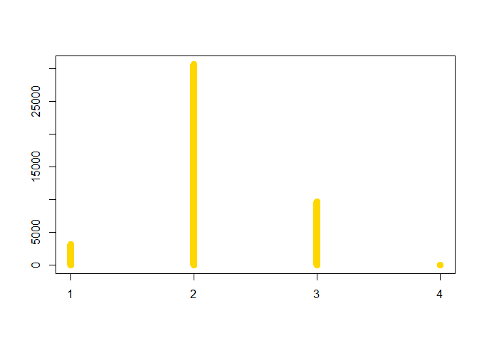
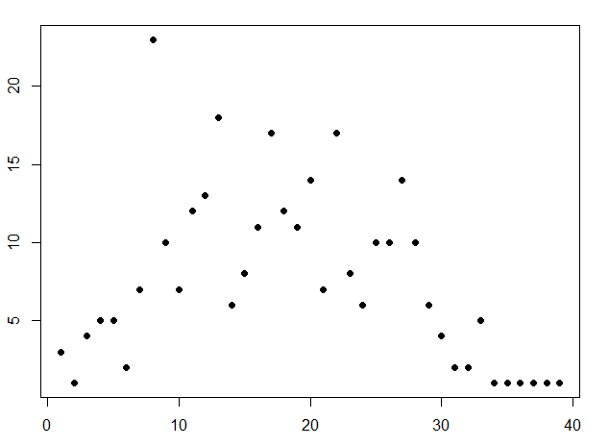
统计学院
SCHOOL OF STATISTICS
Commodity Network
Identifying the strategic value of commodities, digging out core commodities and establishing a new logic for forecasting and early-warning
commodity network path length distribution
commodity network node degree distribution
Data：Annual import or export commodities of the enterprise
Notes:
作者简介：Kurt Weyland

Slide 30
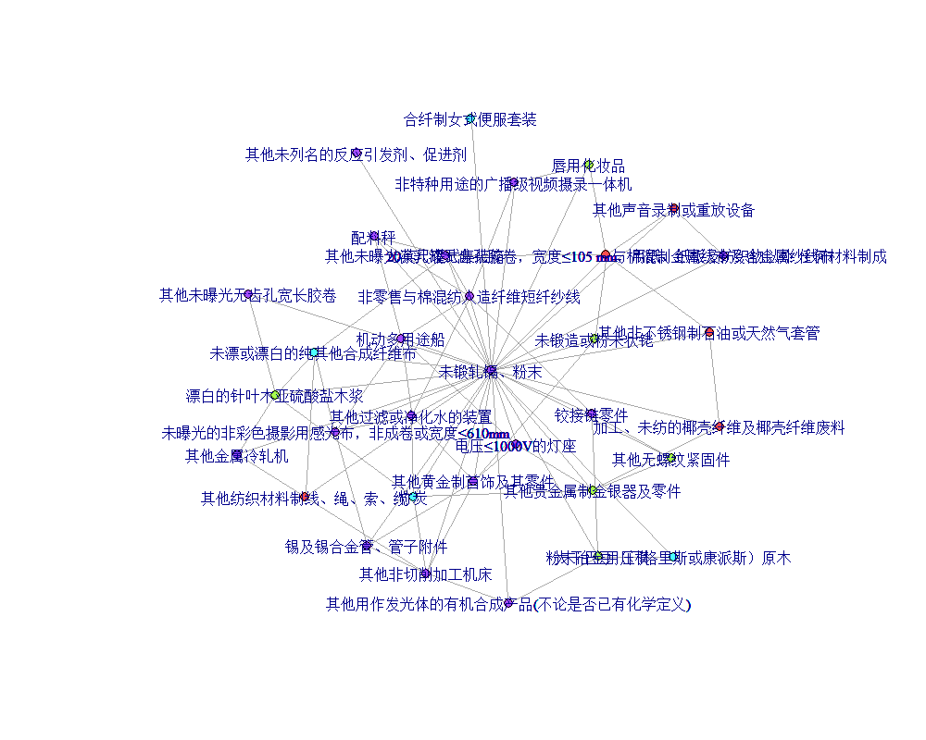
统计学院
SCHOOL OF STATISTICS
Commodity Network Centrality Analysis
Key Commodities Based On Centrality
Degree Centrality | Closeness Centrality | Intermediary
hinge chain parts | machine parts not listed in other tax numbers in this chapter | radar display tube parts
other leather boots with insole length ≥ 24cm (over ankle) | men's woolen hooded cold-proof jacket and windbreaker | inflatable speedboat for recreation or sports
inflatable speedboat for recreation or sports | zinc and zinc alloy bars, rods, profiles, wires | other spun silk yarns not for retail
other sound recording and playback devices using optical media | other pure synthetic fiber cloth | other diesel vehicles with exhaust volume > 4l
zinc and zinc alloy bars, rods, profiles and wires | other synthetic staple fabrics blended with other fibers | other paper-made bobbins, reels
commodities connected to a core commodity
Notes:
作者简介：Kurt Weyland

Slide 31
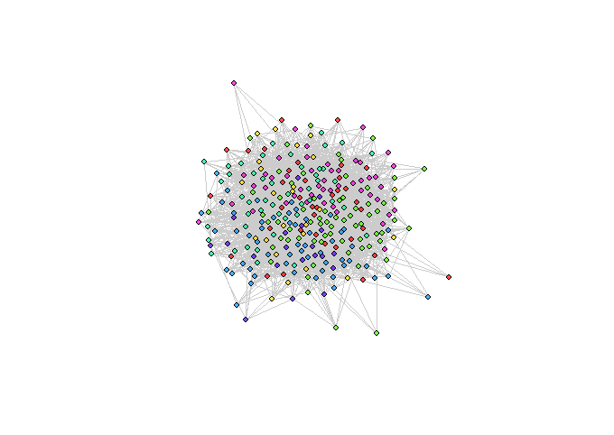
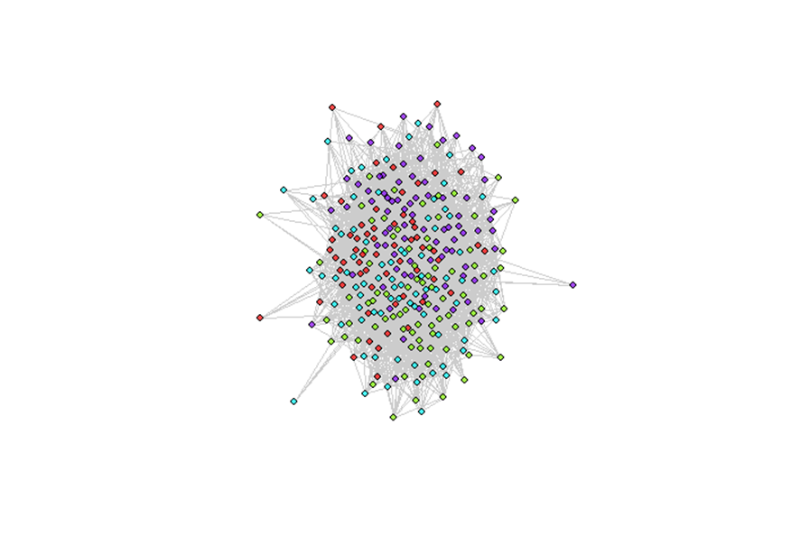
统计学院
SCHOOL OF STATISTICS
Commodity Community Discovery
community division based on FN algorithm
(7 categories)
community division based on spectral clustering algorithm
(4 categories)
Notes:
作者简介：Kurt Weyland

Slide 32
统计学院
SCHOOL OF STATISTICS
Specific Product Discovery
Commodity competitiveness: international competitiveness index, international market share index, comparative advantage index
"Link" commodity mining: trade intensity index, complementarity index
Product portrait: BRICH algorithm, DBSCAN algorithm
Notes:
作者简介：Kurt Weyland

Slide 33
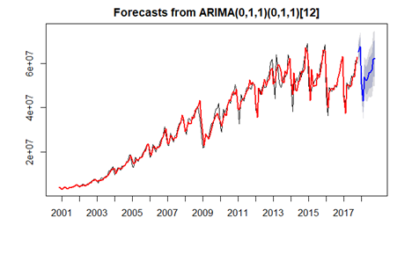
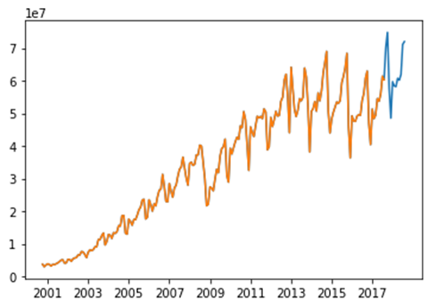
统计学院
SCHOOL OF STATISTICS
Trade Trend Forecast
forecast by ARIMA
forecast by LSTM
Data：Annual high-end commodity exports
Notes:
作者简介：Kurt Weyland

Slide 34
统计学院
SCHOOL OF STATISTICS
Prediction Results
ARIMA & LSTM Estimate
ARIMA vs LSTM
Time | True Value | ARIMA | Error | LSTM | Error
2017·11 | 70210187 | 65443158 | 0.068 | 66730410 | 0.05
2017·12 | 74877581 | 67880415 | 0.093 | 69717820 | 0.069
2018·01 | 57708566 | 50773414 | 0.12 | 54105487 | 0.062
2018·02 | 48527865 | 43139157 | 0.111 | 47948094 | 0.012
2018·03 | 59722520 | 54049001 | 0.095 | 58652436 | 0.018
2018·04 | 58418544 | 52246600 | 0.106 | 55670537 | 0.047
2018·05 | 58195190 | 52910413 | 0.091 | 56922207 | 0.022
2018·06 | 60757985 | 55823102 | 0.081 | 61896573 | 0.019
2018·07 | 60158422 | 55930377 | 0.07 | 60487348 | 0.005
2018·08 | 61934524 | 57058705 | 0.079 | 62357810 | 0.007
2018·09 | 71156106 | 61864542 | 0.131 | 67349601 | 0.053
2018·10 | 72029926 | 62483780 | 0.133 | 66918880 | 0.071
 | ARIMA | LSTM
RMSE | 6393324 | 2951884
MAPE | 0.098 | 0.036
Notes:
作者简介：Kurt Weyland

Slide 35
统计学院
SCHOOL OF STATISTICS
Further Work
Part 3
Resolve Technical Issues
Expand the Scope of Integration
Fill the Gap of Data
Strengthen Big Data Analysis and Application
Notes:
作者简介：Kurt Weyland

Slide 36
统计学院
SCHOOL OF STATISTICS
Technical Issues of Integrating the Two Statistical Systems
  Customs statistics are possibly inconsistent with enterprise statistics in terms of time, scope, classification, and price.
  The name of enterprises may not be the same in the two systems.

Slide 37
统计学院
SCHOOL OF STATISTICS
Expand the Scope of Integration
Survey on key foreign trade enterprises by the Ministry of Commerce
Survey on import and export in key areas of service trade by the Ministry of Commerce
Pilot survey on cross border e-commerce by General Administration of Customs
Statistics on trade credit by Administration of Foreign Exchange
Notes:
作者简介：Kurt Weyland

Slide 38
统计学院
SCHOOL OF STATISTICS
Fill the Gap of Data
How to reflect new business forms, new models, new technologies and new channels?
How to reflect the participation in the global value chain?
  parts, raw materials, intermediate products
How to calculate the value added of trade?
How to reflect the industrial transfer between regions?
Notes:
作者简介：Kurt Weyland

Slide 39
统计学院
SCHOOL OF STATISTICS
Broaden Big Data Analysis and Application
Discover the competitive and cooperative relationship between enterprises through social network analysis
Develop trading partner recommendation system
Introducing the information of trading partner for risk early-warning
Notes:
作者简介：Kurt Weyland

Slide 40
统计学院
SCHOOL OF STATISTICS
Thank You for Listening!

